Slide 1

Welcome alknanda excel ,
Information Of
Basic Excel
£1 ppt

Slide 2

Developer’s Of excel
Meet the two guys who invented the first-ever spreadsheet Before Microsoft's Excel came about, a Harvard MBA student and his former MIT classmate built the first spreadsheet software for the Apple II. It was 1979 and Dan Bricklin and Bob Frankston wanted to see their calculators come to life.
Dan bricklin

Slide 3
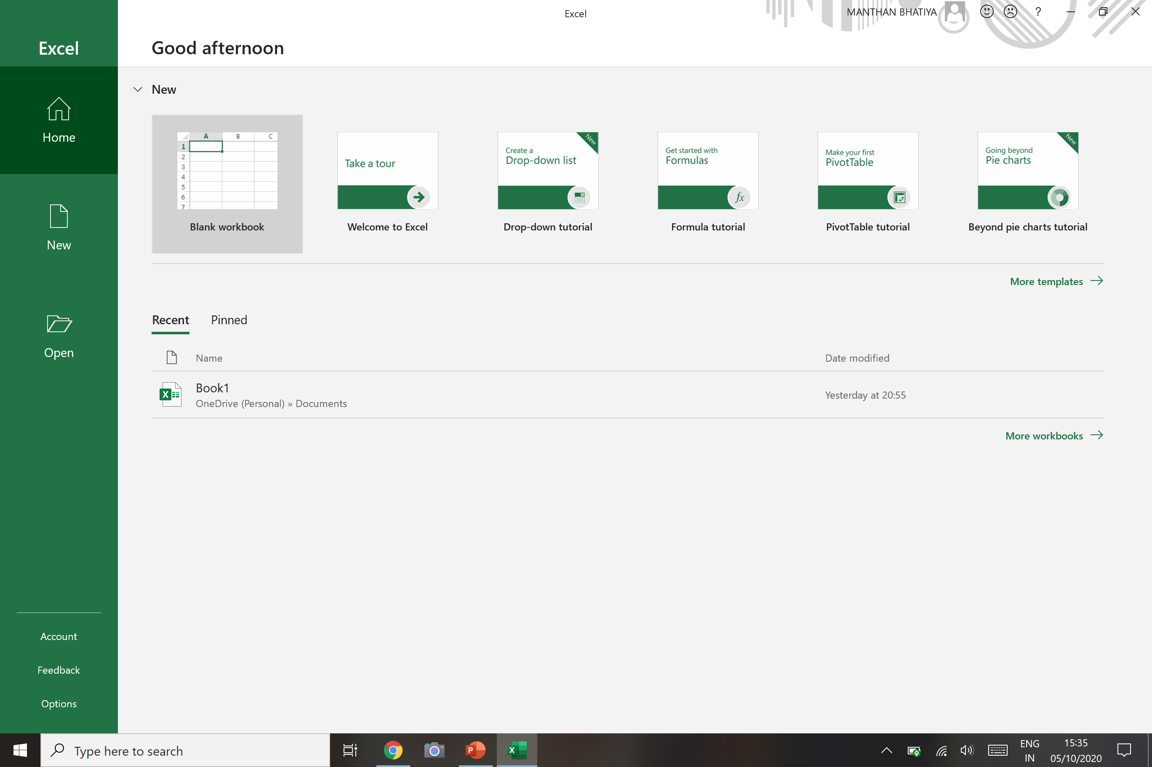
Account
Feedback
Options(settings)

Slide 4
Home
Menu
New Workbook
Open workbook

Slide 5
Your Pinned Files Will Be Here
Your Recent Files Will Be Here

Slide 6
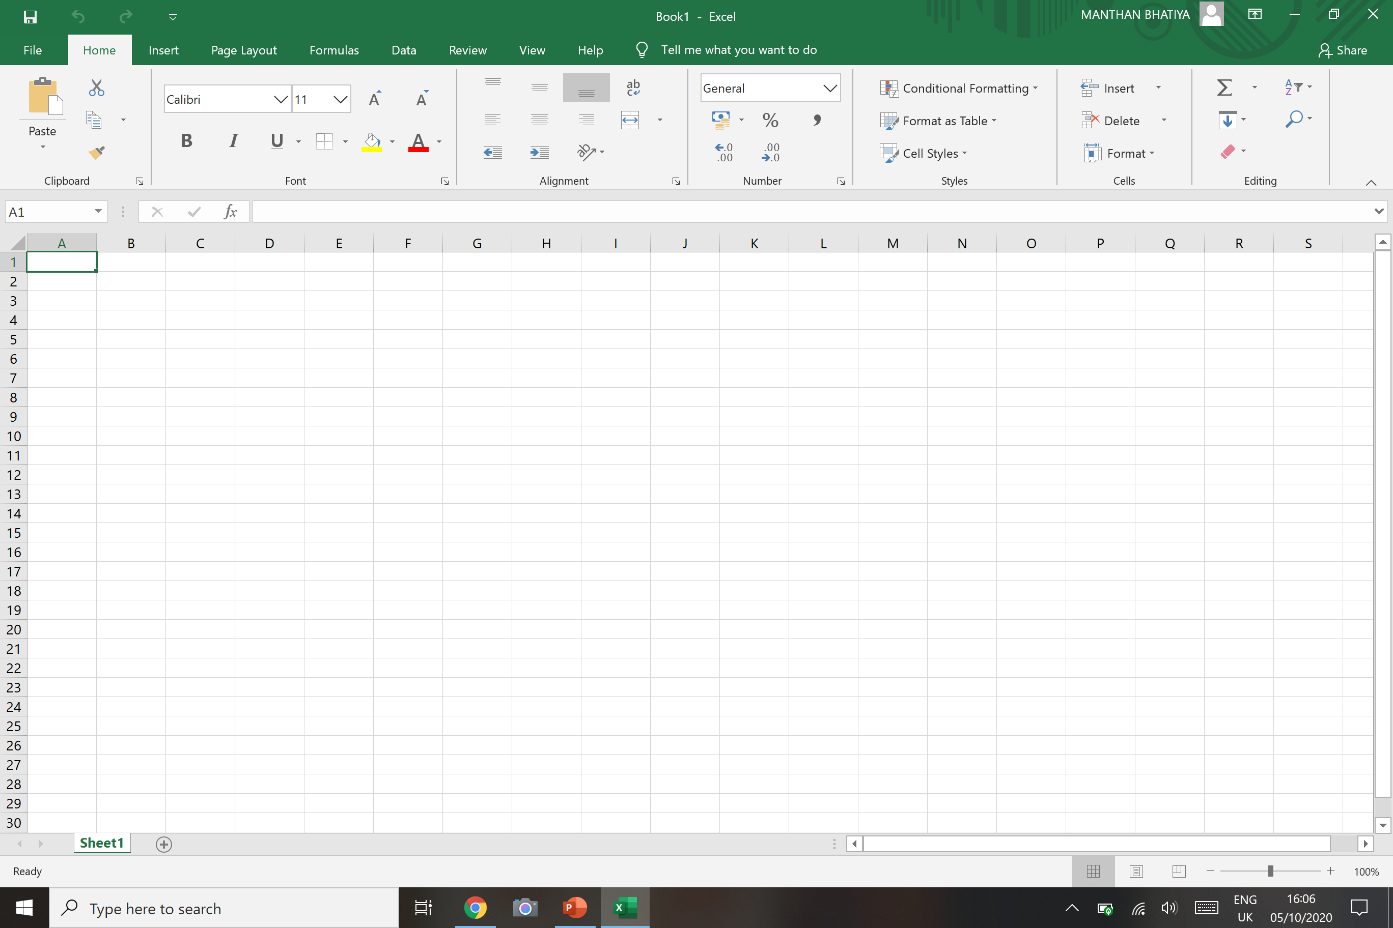
Excel Blank Workbook :- home menu description
Home menu
Cell locater
Formula bar
Sheet name
Click “+” to add new sheet

Slide 7
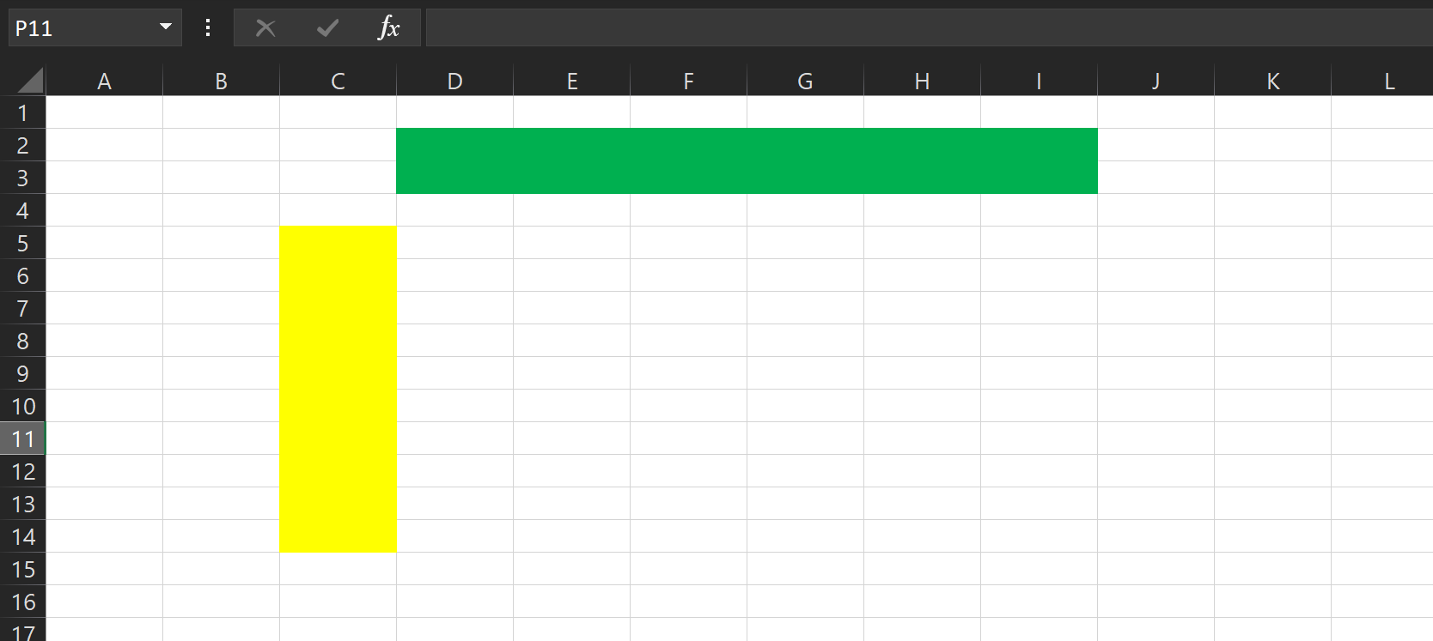
Raw
Column
*Column Knowledge*
10,48,576 columns in latest version
*Raw knowledge*
16,384 Raw in latest version

Slide 8


